Slide 1

Optimizing IT Support: A Data-Driven Analysis of Ticket Management
Ansh Arora

Slide 2
Introduction & Objectives
“ Did you know that inefficient IT ticketing can cost large companies millions in lost productivity? “
This project analyzes the it ticket management process to identify bottlenecks and opportunities for improvement.
To evaluate the efficiency and effectiveness of the current it support team.
To provide data-driven recommendations for strategic investment (hiring, training, or software).
To identify key performance metrics and trends to guide future decisions.

Slide 3
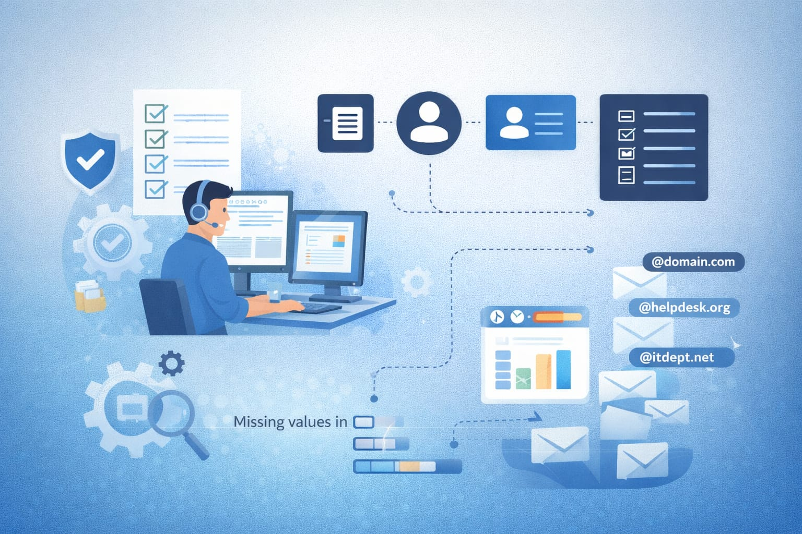
Data Overview
The dataset comprises IT tickets and agent information over a specific period.
Total tickets analyzed: 97498
Number of IT agents: 50
Key attributes: ticket ID, agent, issue category, priority, resolution time, satisfaction rating.
Data preprocessing: mentioned steps like handling missing values in the resolution time column and extracting domains from agent emails.

Slide 4
Methodology
Tools: microsoft excel (pivot tables, formulas, charts).
Analytical steps:
Data cleaning: identified and addressed missing/inconsistent values.
Data enrichment: extracted email domains, calculated resolution times, and created new categorical groups.
Exploratory analysis: used pivot tables to summarize ticket volumes, agent performance, and resolution times by category.
Statistical review: calculated averages and correlations (e.G., Between severity and resolution time).
Dashboard creation: built an interactive dashboard with slicers for dynamic exploration.

Slide 5
Impact of Age Group on IT Support Performance
Insights
20–30 age group shows the highest satisfaction (~4.25) with relatively efficient resolution time (~4.5 days). 31–40 age group has the highest resolution time (~4.6 days) and comparatively lower satisfaction (~4.1). 40+ age group demonstrates stable and balanced performance across both metrics.
Overall, the performance variation across age groups is minimal, indicating consistent service levels.
Younger agents may excel in communication and adaptability, while experienced agents provide stability and consistency.

Slide 6
Ticket Distribution by Request Category
Insights
System issues dominate with 39,002 tickets (~40%), indicating major dependency on system stability and login access issues are the second highest (29,193 ~30%), suggesting frequent authentication or access-related problems.
Software-related tickets (19,570 ~20%) show moderate volume, indicating manageable application-level issues and hardware issues are the lowest (9,733 ~10%), implying relatively fewer physical device failures.
Overall, ~70% of tickets come from system + login issues, highlighting key areas for improvement.

Slide 7
Trend of Satisfaction Rate & Resolution Time Over Time
Insights
Satisfaction rate remains stable (~4.0 – 4.2) across the timeline, indicating consistent service quality and resolution time fluctuates slightly (~4.4 – 4.7 days) but shows no major spikes or drops.
There is a weak inverse relationship — when resolution time increases slightly, satisfaction tends to dip.
Seasonal peaks in ticket volume do not significantly impact satisfaction, indicating good workload handling.

Slide 8
Trend of Ticket Volume Over Time
Insights
Ticket volume shows a clear cyclical/seasonal pattern, with repeated peaks and drops over time.
Peak ticket volume reaches ~2400–2600, indicating high-demand period slowest volume drops to ~1000–1200, showing relatively stable off-peak workload.
The pattern suggests predictable workload cycles, likely tied to business operations or system usage periods and recurring peaks highlight the need for capacity planning and resource allocation during high-demand periods.

Slide 9
Quarterly Resolution Time by Request Category
Insights
Hardware requests consistently take the longest time (~7.5–7.8 days) across all quarters, indicating higher complexity or dependency on physical fixes and system-related issues (~6.5–6.7 days) are the second most time-consuming, showing moderate operational effort.
Software tickets (~5.2–5.5 days) are resolved faster, suggesting better tools or standardized processes and login access issues are resolved the fastest (~0.2–0.4 days), highlighting highly efficient handling of access-related requests.
Resolution time across quarters remains stable with minimal fluctuation, indicating consistent performance.

Slide 10
Ticket Distribution by Severity
Insights
Majority of tickets fall under “normal (2)” severity, indicating most issues are moderate and manageable and very few tickets are “urgent (4)”, which suggests critical incidents are rare.
“Major (3)” tickets are limited, meaning high-impact issues are not frequent and “minor (1)” tickets exist but are relatively low, indicating fewer small issues reported.
“Unclassified (0)” tickets are almost negligible, showing good categorization practices.

Slide 11
Distribution of Tickets Based on Resolution Time
Insights
Highest number of tickets are resolved within 0 days (~25,000) → strong same-day resolution performance.
Significant drop after day 0, but days 1–7 still show steady resolution volume and most tickets are resolved within the first week, indicating efficient handling.
After day 10, ticket volume reduces sharply, meaning very few long-pending issues and very minimal tickets beyond 15 days, suggesting backlog is well controlled.

Slide 12
Distribution of Tickets Based on Satisfaction Score
Insights
Score 5 has the highest count (~50,000) → indicates excellent customer satisfaction and score 4 is also significantly high (~27,000) → majority of users are happy with the service.
Very few low ratings (1 & 2) → minimal dissatisfaction among users and score 3 is moderate, suggesting some room for improvement.
Overall, customer satisfaction is strongly positive, with most ratings being 4 or 5.

Slide 13
Strategic Recommendation 1: Targeted Training Programs
Recommendation: use a portion of the funds to develop a targeted training program for specific agents and on specific issue categories.
Data-driven reason:
Agents in the bottom right have been identified as needing performance support (slide 10).
The hardware category has the longest resolution times, suggesting a team-wide skill gap on this issue type (slide 11).
Expected impact: upskilling agents on complex issues will directly lower resolution times for those tickets and improve overall customer satisfaction.

Slide 14
Strategic Recommendation 2: Consider Hiring (with Caution)
Recommendation: de-prioritize immediate hiring. Instead, focus on optimizing the current team's efficiency.
Data-driven reason:
While ticket volume is [increasing], the current team is managing it with a [stable/improving] average resolution time (slide 13).
Investing in technology and training can likely unlock more capacity from the existing team, which is more cost-effective than immediate hiring.
Future consideration: re-evaluate this in 6 months. If volume outpaces the efficiency gains from tech/training, then hiring becomes the clear next step.

Slide 15
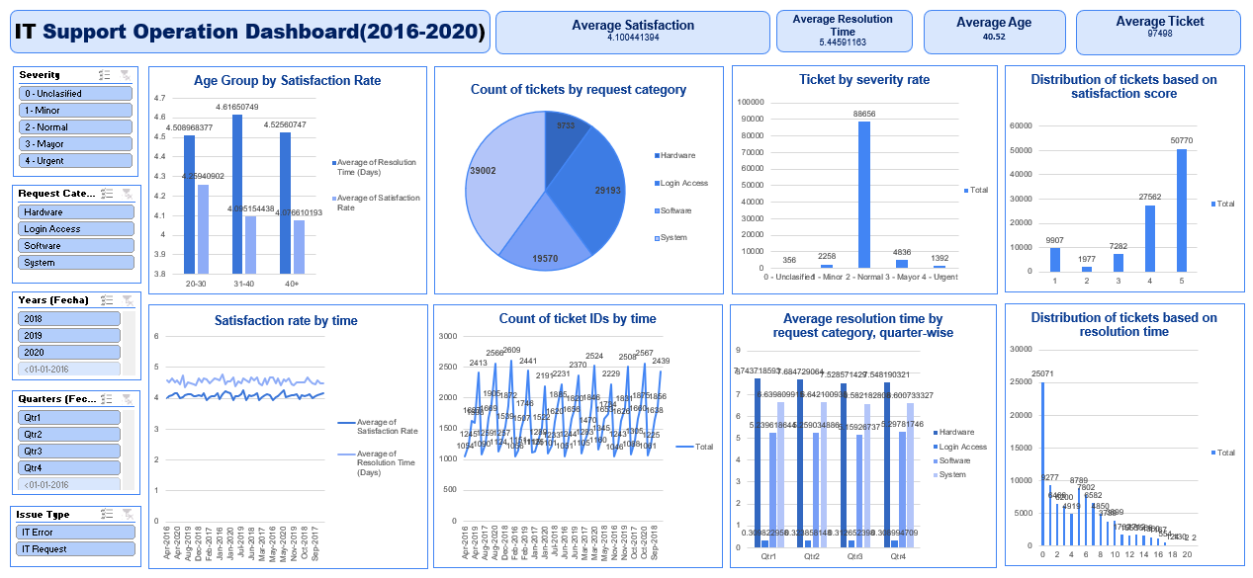
Dashboard

Slide 16
Conclusion
Summary of key findings: the IT team is performing well, but significant opportunities exist to improve efficiency and satisfaction.
Main recommendations:
Prioritize investment in software/tools for the biggest impact.
Implement targeted training for agents with performance gaps and on complex issue types.
Optimize current team capacity before expanding headcount.
"By taking a data-driven approach to these strategic investments, we can transform our it support from a reactive cost center into a proactive driver of employee productivity and satisfaction."

Slide 17
Acknowledgements & References
Data source: internal IT ticketing system data.
Tools used: microsoft excel.
Acknowledgements: thanks to any mentors or team members who assisted with the project.

